Slide 1

Parking Queue System

Slide 2
Car parking Queue System
Group C1.1
TA: Maha Farghaly
Ziad Khaled Hamdy 20210489
Mohamed Alaaeldin 20213854
Ahmed Yasser Ahmed 20213939

Slide 3
Introduction to Parking Queue System
Overview of a system designed to manage and optimize parking queues, ensuring efficient parking space utilization and better traffic flow.

Slide 4
Objective for Parking Queue System
Minimize Waiting Times: Reduce the average waiting times for customers by implementing efficient queue management strategies and optimizing the allocation of parking spaces.
Maximize Parking Utilization: Ensure optimal usage of parking spots by effectively managing the allocation and turnover of spaces, thereby reducing congestion and improving overall space utilization.
Utilize Technology for Optimization: Integrate technological solutions such as sensors, smart parking systems, and digital signage to streamline operations, provide real-time information, and enhance overall system efficiency.

Slide 5
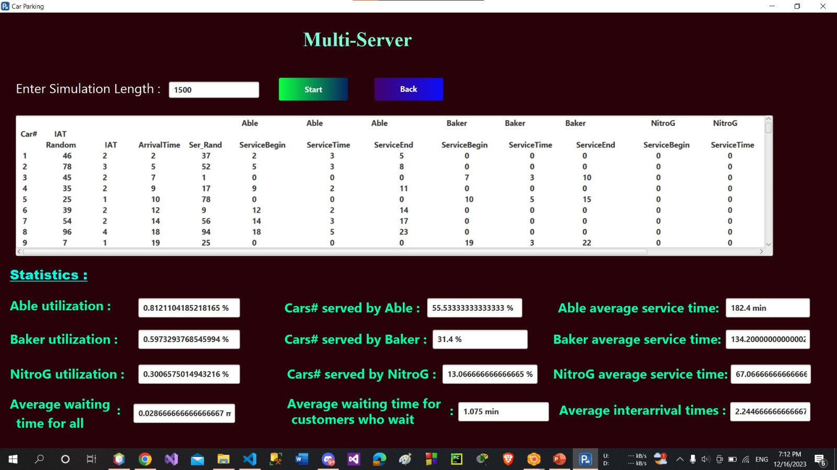
the average waiting time is a minute and some
seconds because the number of customers is very large and this affects the operations of the servers

Slide 6
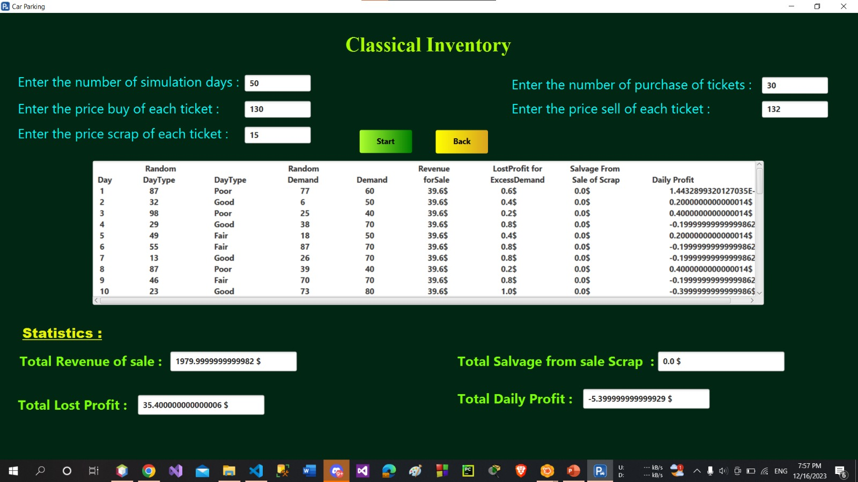
there will be a total loss of 5$ because the buying price is close to the selling price and the number of purchase of tickets is little
When we have many orders, we must make sure about number of purchase of tickets Appropriate.

Slide 7
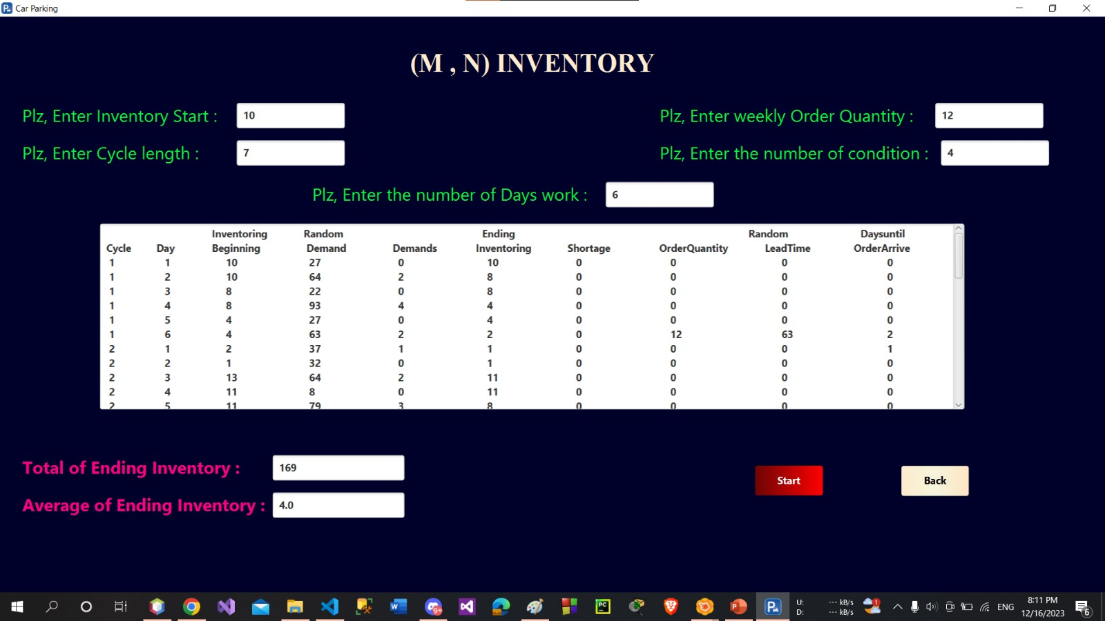
A relatively high total ending inventory 169 suggests that the parking lot might be overstocked, on average.
The average ending inventory of 4.0 cars is lower than the total ending inventory, indicating that the parking lot is not constantly full.

Slide 8
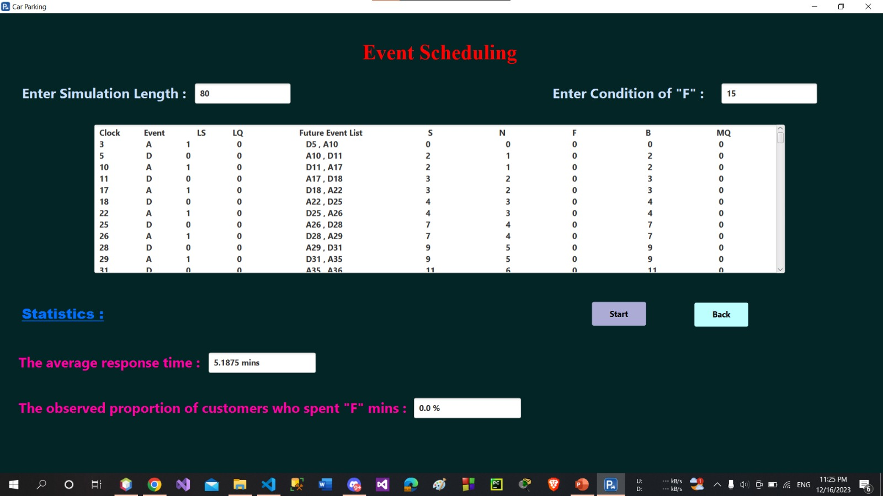
The average response time is 5.1875 minutes. This means that on average, it takes 5.1875 minutes for a customer to enter the car park and then depart.
The observed proportion total of customers who spent 5 minutes or more is 0.0%. This means that the simulation ended quickly and without expectations of waiting.

Slide 9
Conclusion
the parking queue system stands as a critical component in optimizing the efficiency and enhancing the customer experience within parking facilities. Through meticulous analysis, experimentation, and implementation of various strategies, it becomes evident that the effective management of queues, parking spot allocation, and customer waiting times are pivotal for a seamless operational flow.

